Slide 1

overall_1_132573879104528179 columns_1_132573879104528179
Microsoft Office Add-ins
Community call
Word Extensibility Update
March 8, 2023

Slide 2

Agenda
Yun Wang
Principal Product Manager

Slide 3

Word Extensibility Update
Yun Wang: Principal Product Manager

Slide 4
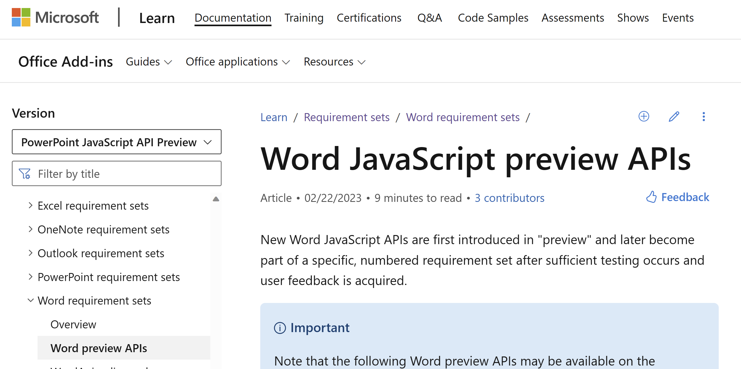
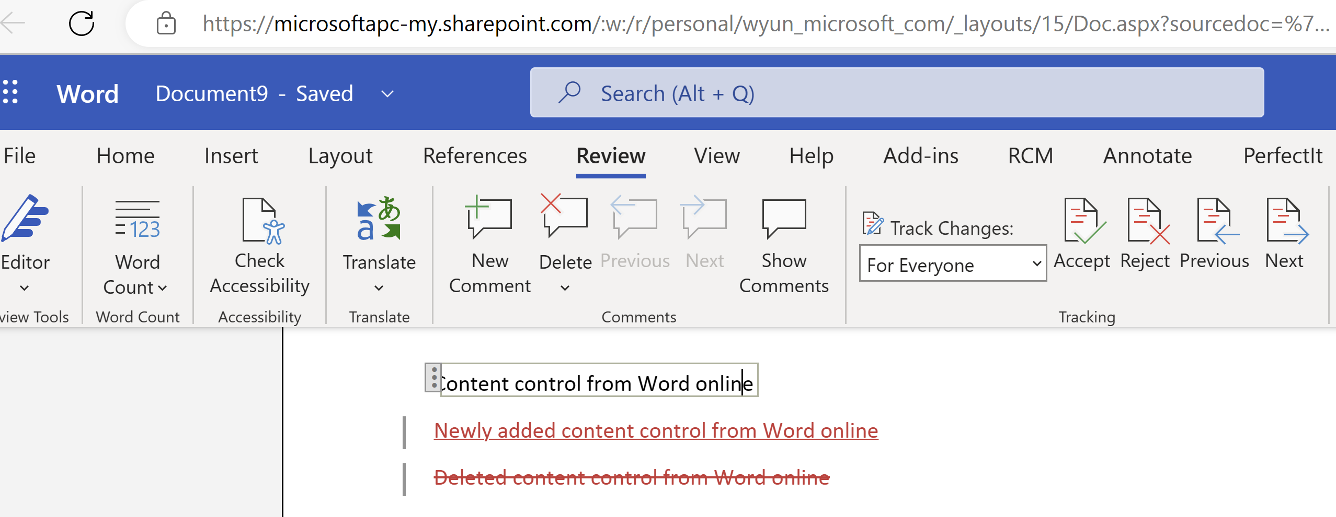
Updates of Word API and Word Online
New features in Word API Preview requirement set are available to test
Supported desktop version 16.0.16130.20218 and above
Word JavaScript preview APIs - Office Add-ins | Microsoft Learn
Feature list
Document.InsertFileFromBase64
Application.retrieveStylesFromBase64
API now can recognize deleted content controls when track changes is on
Plain text content control support
OnEnter, OnExited content control events
Save/Close APIs
Style APIs
Field APIs
New feature of Word online
Track changes for content controls is in production
Notes:
m365-dev-sig

Slide 5
Demo
InsertFileFromBase64 enhancement
Recognized deleted content controls when track changes is on

Slide 6
Call for writing assistant partners
Please fill the form here: https://forms.office.com/r/jqBHuxWy4S
Notes:
m365-dev-sig

Slide 7
Question:
Will TaskPane in Outlook addin support change default width?
Answer:
We do not have any plans to support this in the near future.
Q&A

Slide 8
Question:
I am looking at developing an add-in for Powerpoint. As the task pane and content add-in have different functions, are we able to essentially combine them into one add-in for the user? Or are there any issues with having two types of add-ins, with one add-in drawing information from the other? Would also like to know if there are any restrictions or security issues from developing the add-in this way.
Answer:
It is not currently possible to develop a taskpane and content add-in in one add-in project. If you would like to submit a feature request with more information about your specific scenario go here https://aka.ms/m365dev-suggestions
Q&A

Slide 9
Question:
Last month, you asked for missing Outlook events so that ISVs can migrate their existing Outlook COM add-ins to the new web based add-ins. With that in mind, we are looking for the following: 1) The ability to display a dialog when a Compose, Reply, Reply All, or Forward is clicked. The customers want to either display a warning or in some cases (like the Compose) they want to force the user to select from a list of pre-defined subjects (this is for a help desk scenario). Other (mostly legal) customers want to see a very prominent prompt show up when clicking on Reply All. 2) The ability to support on-send Outlook events (or Smart Alerts) in iPhone or Android. This is a frequent request from our customers and we need a roadmap from the Office team to know whether this is a planned feature or not, and what to tell our customers.
Answer:
Currently tracking down the answers to these questions. Will be present in the blog post.
Q&A

Slide 10






New to Office Add-ins?
 | Documentation | https://aka.ms/office-add-ins-docs
 | Quick starts | Outlook, Excel, Word, PowerPoint
 | Script Lab | https://aka.ms/getscriptlab
 | Samples | https://aka.ms/officeaddinsamples
 | Microsoft 365 Developer Program | https://aka.ms/M365devprogram
 | Office Scripts | aka.ms/office-scripts-docs
Notes:
m365-dev-sig

Slide 11
Engage with the team
Engagement | Where to go
Technical questions about Office Add-ins | https://aka.ms/office-addins-dev-questions [office-js-dev] [office-addins-dev] https://stackoverflow.com [office-js] [outlook-web-addins] [office-scripts]
Product bugs | https://github.com/OfficeDev/office-js
Feature requests and ideas | https://aka.ms/m365dev-suggestions
Send a Smile or Frown | Inside Office
Notes:
m365-dev-sig

Slide 12
Microsoft 365 developer community calls
Microsoft 365 platform call (weekly) https://aka.ms/m365-dev-call
Microsoft 365 & Power Platform Development (bi-weekly) https://aka.ms/m365-dev-sig
Viva Connections &
SharePoint Framework (bi-weekly) https://aka.ms/spdev-spfx-call
Microsoft identity platform (monthly) https://aka.ms/IDDevCommunityCalendar
Office Add-ins (monthly) https://aka.ms/officeaddinscommunitycall
Power Platform (monthly) https://aka.ms/PowerPlatformMonthlyCall
All calls and assets: https://aka.ms/m365pnp
Notes:
m365-dev-sig

Slide 13
Thank you
Recording will be available in approx. 48 hours on
Microsoft 365 Community (PnP) YouTube channel
https://aka.ms/M365PnP/videos
(subscribe today)
Follow us on Twitter
@Microsoft365Dev | @M365PnP
Next call: April 12th at 8:00 AM Pacific Time
https://aka.ms/officeaddinscommunitycall
Agenda: https://aka.ms/officeaddinsagenda
Submit your questions: https://aka.ms/officeaddinsform

